Slide 1
CC0002 NAVIGATING THE DIGITAL WORLD
Course Handbook
AY2023/24 SEM 2

Slide 2
Content
Title | Slide Number
Intended Learning Outcomes | 3
Learning Modules Module 1 to Module 7 | 4
Weekly Timetable Week 1 to Week 13 details Tutorial Venue Tutorial Details | 5 - 11
CC0002 Assessments Four Assessment Components Video learning Module, Quiz, Team Project Assignment + Presentation Class Participation + in-class presentation & discussion | 12 - 31
Miscellaneous Information | 32

Slide 3
Intended Learning Outcome (ILO)
Apply
structured approaches to solve complex problems by breaking them into subproblems.
Apply
quantitative reasoning to analyze data, guide problem-solving, and support decision making.
Use
digital tools and technologies to search for, assess, analyze, develop, and share digital content and solutions through different media forms.
Interact and collaborate
through digital platforms
/channels.
Demonstrate
one’s use of digital technology and online presence responsibly, ethically, legally, and with care.
Describe
current developments and issues in the digital world.

Slide 4
Modules
1. Computation Thinking and Problem Solving
2. Quantitative Reasoning Techniques
3. Managing Cybersecurity
5. Principles of Data Ethics in the Digital World
4. The world of Digital Misinformation
6. Intellectual Properties, Rights and Data Privacy
7. Latest and Emerging Technology Trends:
Introduction to Artificial Intelligence
Learning Modules

Slide 5
Weekly Timetable Please Note: Holidays: 10-12th February 29th March, and 10th April. If your class falls on a holiday, your tutor will arrange for a makeup. *All undergraduate programme courses will be conducted as HBL as per University’s initiative on implementing the NTU-level e-learning week. All our CC0002 tutorials will be conducted in an online mode. (please note: this week also collides with Chinese New Year Holiday – tutors will arrange for an online makeup class).
Week | Video Learning Modules releasing week. (Mode: Online) | Tutorial Topics (Mode: face – to-face)
Week 1 (15 Jan – 19 Jan) | Module 1 | Introduction to CC0002
Week 2 (22 Jan – 26 Jan) | Modules 1 & 2 | Module 1 Tutorial
Week 3 (29 Jan – 2 Feb) | Modules 1, 2 & 3 | Module 1 Tutorial
Week 4 (5 Feb – 9 Feb) | Modules 2, 3 & 4 | Module 2 Tutorial
Week 5 (12 Feb – 16 Feb) | Modules 3, 4 & 5 | Module 2 Tutorial (Conducted as Home Based Learning (HBL)*
Week 6 (19 Feb – 23 Feb) | Modules 4, 5 & 6 | Module 3 Tutorial
Week 7 (26 Feb – 1 Mar) | Modules 5, 6 & 7 | Module 4 Tutorial + Project Consultation
Recess Week
Week 8 (11 Mar – 15 Mar) | Modules 6 & 7 | Module 5 Tutorial + Project Consultation
Week 9 (18 Mar – 22 Mar) | Module 7 | Module 6 Tutorial
Week 10 (25 Mar – 29 Mar) | None | Module 7 Tutorial
Week 11 (1 Apr – 5 Apr) | None | Module 7 Tutorial
Week 12 (8 Apr – 12 Apr) | None | Team Project Presentation + Quiz
Week 13 (15 Apr – 19 Apr) | None | Team Project Presentation + Quiz makeup

Slide 6
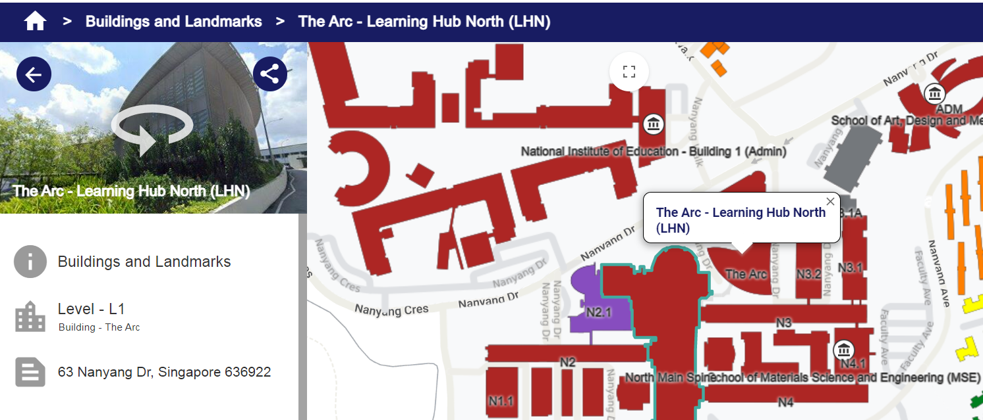
Weekly Timetable – Tutorial Venue: The Arc
How to get there: https://maps.ntu.edu.sg/

Slide 7
Weekly Timetable – Tutorial Details
Class Group | Day | Start Time | End Time | Venue | Instructor's Name | Title | Instructor's email
T01 | M | 10:30 | 12:20 | LHN-TR+04 | Alex Chichung KOT | Prof | eackot@ntu.edu.sg
T02 | M | 10:30 | 12:20 | LHN-TR+30 | Leedham Charles Graham | Dr | graham.leedham@ntu.edu.sg
T03 | M | 10:30 | 12:20 | LHN-TR+36 | Vidya Sudarshan | Dr | vidya.sudarshan@ntu.edu.sg
T04 | M | 10:30 | 12:20 | LHN-TR+37 | Marc Low | Mr | ACWLow@ntu.edu.sg
T05 | M | 12:30 | 14:20 | LHN-TR+04 | Cheng Jiaxiang | Mr | JIAXIANG002@e.ntu.edu.sg
T06 | M | 12:30 | 14:20 | LHN-TR+30 | Leedham Charles Graham | Dr | graham.leedham@ntu.edu.sg
T07 | M | 12:30 | 14:20 | LHN-TR+36 | Ricky Chua | Dr | ricky.chua@ntu.edu.sg
T08 | M | 12:30 | 14:20 | LHN-TR+37 | Marc Low | Mr | ACWLow@ntu.edu.sg
T09 | M | 14:30 | 16:20 | LHN-TR+04 | Cheng Jiaxiang | Mr | JIAXIANG002@e.ntu.edu.sg
T10 | M | 14:30 | 16:20 | LHN-TR+30 | Leedham Charles Graham | Dr | graham.leedham@ntu.edu.sg
T11 | M | 14:30 | 16:20 | LHN-TR+36 | Vidya Sudarshan | Dr | vidya.sudarshan@ntu.edu.sg
T12 | M | 14:30 | 16:20 | LHN-TR+37 | Tan Yong Heng Michael | Mr | michael.tan@ntu.edu.sg
T13 | M | 16:30 | 18:20 | LHN-TR+04 | Tan Yong Heng Michael | Mr | michael.tan@ntu.edu.sg
T14 | M | 16:30 | 18:20 | LHN-TR+30 | Vidya Sudarshan | Dr | vidya.sudarshan@ntu.edu.sg
T15 | T | 10:30 | 12:20 | LHN-TR+04 | Koh Kian Hoe Benjamin | Mr | benjamin.koh@ntu.edu.sg

Slide 8
Weekly Timetable – Tutorial Details
Class Group | Day | Start Time | End Time | Venue | Instructor's Name | Title | Instructor's email
T16 | T | 10:30 | 12:20 | LHN-TR+30 | Leedham Charles Graham | Dr | graham.leedham@ntu.edu.sg
T17 | T | 10:30 | 12:20 | LHN-TR+36 | Josephine Chong | Dr | josephine.chong@ntu.edu.sg
T18 | T | 10:30 | 12:20 | LHN-TR+37 | Ricky Chua | Dr | ricky.chua@ntu.edu.sg
T19 | T | 12:30 | 14:20 | LHN-TR+04 | Vidya B | Dr | bvidya@ntu.edu.sg
T20 | T | 12:30 | 14:20 | LHN-TR+30 | Leedham Charles Graham | Dr | graham.leedham@ntu.edu.sg
T21 | T | 12:30 | 14:20 | LHN-TR+36 | Ricky Chua | Dr | ricky.chua@ntu.edu.sg
T22 | T | 12:30 | 14:20 | LHN-TR+37 | Mohammed Yakoob Siyal | Assoc Prof | eyakoob@ntu.edu.sg
T23 | T | 14:30 | 16:20 | LHN-TR+04 | Vidya B | Dr | bvidya@ntu.edu.sg
T24 | T | 14:30 | 16:20 | LHN-TR+30 | Tan Yong Heng Michael | Mr | michael.tan@ntu.edu.sg
T25 | T | 14:30 | 16:20 | LHN-TR+36 | Josephine Chong | Dr | josephine.chong@ntu.edu.sg
T26 | T | 14:30 | 16:20 | LHN-TR+37 | Marc Low | Mr | ACWLow@ntu.edu.sg
T27 | T | 16:30 | 18:20 | LHN-TR+04 | Michael | Mr | michael.tan@ntu.edu.sg
T28 | T | 16:30 | 18:20 | LHN-TR+30 | Leedham Charles Graham | Dr | graham.leedham@ntu.edu.sg
T29 | W | 10:30 | 12:20 | LHN-TR+04 | Ricky Chua | Dr | ricky.chua@ntu.edu.sg
T30 | W | 10:30 | 12:20 | LHN-TR+30 | Leedham Charles Graham | Dr | graham.leedham@ntu.edu.sg

Slide 9
Weekly Timetable – Tutorial Details
Class Group | Day | Start Time | End Time | Venue | Instructor's Name | Title | Instructor's email
T31 | W | 10:30 | 12:20 | LHN-TR+36 | Marc Low | Mr | ACWLow@ntu.edu.sg
T32 | W | 10:30 | 12:20 | LHN-TR+37 | Vijay Sethi | Prof | avsethi@ntu.edu.sg
T33 | W | 12:30 | 14:20 | LHN-TR+04 | Mohammed Yakoob Siyal | Assoc Prof | eyakoob@ntu.edu.sg
T34 | W | 12:30 | 14:20 | LHN-TR+30 | Leedham Charles Graham | Dr | graham.leedham@ntu.edu.sg
T35 | W | 12:30 | 14:20 | LHN-TR+36 | Ricky Chua | Dr | ricky.chua@ntu.edu.sg
T36 | W | 12:30 | 14:20 | LHN-TR+37 | Vijay Sethi | Prof | avsethi@ntu.edu.sg
T37 | W | 14:30 | 16:20 | LHN-TR+04 | Zhou Xing | Assoc Prof | exzhou@ntu.edu.sg
T38 | W | 14:30 | 16:20 | LHN-TR+30 | Leedham Charles Graham | Dr | graham.leedham@ntu.edu.sg
T39 | W | 14:30 | 16:20 | LHN-TR+36 | Marc Low | Mr | ACWLow@ntu.edu.sg
T40 | W | 14:30 | 16:20 | LHN-TR+37 | Ricky Chua | Dr | ricky.chua@ntu.edu.sg
T41 | W | 16:30 | 18:20 | LHN-TR+04 | Fannie Zhang | Dr | fannie.zhang@ntu.edu.sg
T42 | W | 16:30 | 18:20 | LHN-TR+30 | Leedham Charles Graham | Dr | graham.leedham@ntu.edu.sg
T43 | TH | 10:30 | 12:20 | LHN-TR+04 | Neerja Sethi | Ms | aneerja@ntu.edu.sg
T44 | TH | 10:30 | 12:20 | LHN-TR+30 | Koh Kian Hoe Benjamin | Mr | benjamin.koh@ntu.edu.sg
T45 | TH | 10:30 | 12:20 | LHN-TR+36 | Loo Dong Lin | Mr | donglin.loo@ntu.edu.sg
T46 | TH | 10:30 | 12:20 | LHN-TR+37 | Ong Chin Ann | Dr | chinann.ong@ntu.edu.sg

Slide 10
Weekly Timetable – Tutorial Details
Class Group | Day | Start Time | End Time | Venue | Instructor's Name | Title | Instructor's email
T47 | TH | 12:30 | 14:20 | LHN-TR+04 | Neerja Sethi | Ms | aneerja@ntu.edu.sg
T48 | TH | 12:30 | 14:20 | LHN-TR+30 | Koh Kian Hoe Benjamin | Mr | benjamin.koh@ntu.edu.sg
T49 | TH | 12:30 | 14:20 | LHN-TR+36 | Marc Low | Mr | ACWLow@ntu.edu.sg
T50 | TH | 12:30 | 14:20 | LHN-TR+37 | Loo Dong Lin | Mr | donglin.loo@ntu.edu.sg
T51 | TH | 14:30 | 16:20 | LHN-TR+04 | FWJ | Assoc Prof | ewjfan@ntu.edu.sg
T52 | TH | 14:30 | 16:20 | LHN-TR+30 | Liu Yu | Dr | yu.liu@ntu.edu.sg
T53 | TH | 14:30 | 16:20 | LHN-TR+36 | Ong Chin Ann | Dr | chinann.ong@ntu.edu.sg
T54 | TH | 14:30 | 16:20 | LHN-TR+37 | Ricky Chua | Dr | ricky.chua@ntu.edu.sg
T55 | TH | 16:30 | 18:20 | LHN-TR+04 | Marc Low | Mr | ACWLow@ntu.edu.sg
T56 | TH | 16:30 | 18:20 | LHN-TR+30 | Loo Dong Lin | Mr | donglin.loo@ntu.edu.sg
T57 | F | 10:30 | 12:20 | LHN-TR+04 | Neerja Sethi | Ms | aneerja@ntu.edu.sg
T58 | F | 10:30 | 12:20 | LHN-TR+30 | LYH | Assoc Prof | eyhlee@ntu.edu.sg
T59 | F | 10:30 | 12:20 | LHN-TR+36 | Ong Chin Ann | Dr | chinann.ong@ntu.edu.sg
T60 | F | 10:30 | 12:20 | LHN-TR+37 | Vijay Sethi | Prof | avsethi@ntu.edu.sg

Slide 11
Weekly Timetable – Tutorial Details
Class Group | Day | Start Time | End Time | Venue | Instructor's Name | Title | Instructor's email
T61 | F | 12:30 | 14:20 | LHN-TR+04 | Marc Low | Mr | ACWLow@ntu.edu.sg
T62 | F | 12:30 | 14:20 | LHN-TR+30 | Loo Dong Lin | Mr | donglin.loo@ntu.edu.sg
T63 | F | 12:30 | 14:20 | LHN-TR+36 | Vijay Sethi | Prof | avsethi@ntu.edu.sg
T64 | F | 12:30 | 14:20 | LHN-TR+37 | Vidya Sudarshan | Dr | vidya.sudarshan@ntu.edu.sg
T65 | F | 14:30 | 16:20 | LHN-TR+04 | Marc Low | Mr | ACWLow@ntu.edu.sg
T66 | F | 14:30 | 16:20 | LHN-TR+30 | Tan Yong Heng Michael | Mr | michael.tan@ntu.edu.sg
T67 | F | 14:30 | 16:20 | LHN-TR+36 | Loo Dong Lin | Mr | donglin.loo@ntu.edu.sg
T68 | F | 14:30 | 16:20 | LHN-TR+37 | Josephine Chong | Dr | josephine.chong@ntu.edu.sg
T69 | F | 16:30 | 18:20 | LHN-TR+04 | Fannie Zhang | Dr | fannie.zhang@ntu.edu.sg
T70 | F | 16:30 | 18:20 | LHN-TR+30 | Tan Yong Heng Michael | Mr | michael.tan@ntu.edu.sg

Slide 12
CC0002 Assessments
This course has four assessment components – (1) VLMs, (2) Quiz, (3) Team Project Assignment, (4) Class Participation including in-class presentation and discussion.
Assessment Components | Individual / Group | Weighting
Video Learning Modules (VLMs) | Individual | 10%
Quiz | Individual | 35%
Team Project Assignment (+ Peer Evaluation) 1. Project work 2. Project Presentation | Group | 20% 15%
Class Participation, in-class Presentation and Discussion | Individual + Group | 10% (class participation) +10% (in-class presentation and discussion)

Slide 13
Individual Assessment Video Learning Module (VLM)
Online videos to be watched weekly which contains Knowledge Check (KC) questions
Released on Mondays, one module at a time
Weightage: 10% of your assessment
This is a single attempt assessment, and No extension is given for this assessment to any kind of request.
Please refer to the table (next slide) for releasing dates and deadlines set for VLM.

Slide 14
Individual Assessment Video Learning Module (VLM) – Important Dates
Releasing Week - Modules | Video Learning Modules releasing date | Video Learning Modules deadline
Week 1 – Module 1 (15 Jan – 19 Jan) | 15th January 8:00am | 2nd February 11:59pm
Week 2 – Module 2 (22 Jan – 26 Jan) | 22nd January 8:00am | 9th February 11:59pm
Week 3 – Module 3 (29 Jan – 2 Feb) | 29th January 8:00am | 16th February 11:59pm
Week 4 – Module 4 (5 Feb – 9 Feb) | 5th February 8:00am | 23rd February 11:59pm
Week 5 – Module 5 (12 Feb – 16 Feb) | 12th February 8:00am | 1st March 11:59pm
Week 6 – Module 6 (19 Feb – 23 Feb) | 19th February 8:00am | 15th March 11:59pm
Week 7 – Module 7 (26 Feb – 1 Mar) | 26th February 8:00am | 22nd March 11:59pm
Any request to extend the deadline will not be entertained.

Slide 15
Individual Assessment: Quiz
CC0002 has one quiz conducted on week 12 (11th April 2024, Thursday), at in-campus lecture theatres (LTs), which contributes 35% weightage to the total.
Quiz contains 50 MCQ based questions to be answered in 40 minutes; syllabus includes all 7 modules which are covered in this course and in addition, VLMs concepts, tutorial materials and additional reading materials are included for quiz. Scope of the quiz will be announced on Week 8 in NTULearn.
Students are required to bring their laptop to the quiz venue updated with all the required software (lockdown browser).

Slide 16
Individual Assessment: Quiz
Venue | Tutorial Class (Session) | Chief Invigilator | Invigilators
To be announced on Week 10 | T01 to T05 (S1) T32 to T36 (S2) | Mr. Tan Yong Heng Michael | Cheng Jiaxiang
 | T06 to T11 (S1) T37 to T42 (S2) | A/P Mohammed Yakoob Siyal | Neerja Sethi
 | T12 to T17 (S1) T43 to T48 (S2) | Prof Vijay Sethi | Fannie Zhang
 | T18 to T22 (S1) T49 to T53 (S2) | Dr Josephine Chong | Ong Chin Ann
 | T23 to T31 (S1) T54 to T62 (S2) | Dr Vidya Sudarshan | Loo Dong Lin
 | T63 to T66 (S1) T67 to T70 (S2) | A/P Zhou Xing | Koh Kian Hoe Benjamin
S1 = Session 1 (645pm-740pm), S2 = Session 2 (8pm-8:55pm). See later slides on quiz timing for more details

Slide 17
Individual Assessment Quiz Timing
6:30pm – 6:45pm (Venue preparation)
6:45pm – 7:00pm (Session 1 enters quiz venue)
7:00pm – 7:40pm (Session 1 quiz)
7:40pm – 8:00pm (Session 1 leaves quiz venue)
8:00pm – 8:15pm (Session 2 enters quiz venue)
8:15pm – 8:55pm (Session 2 quiz)
8:55pm (Session 2 leaves quiz venue)

Slide 18

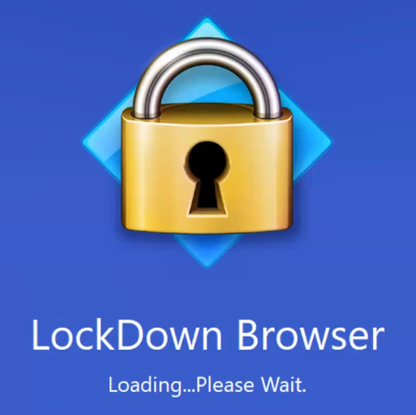
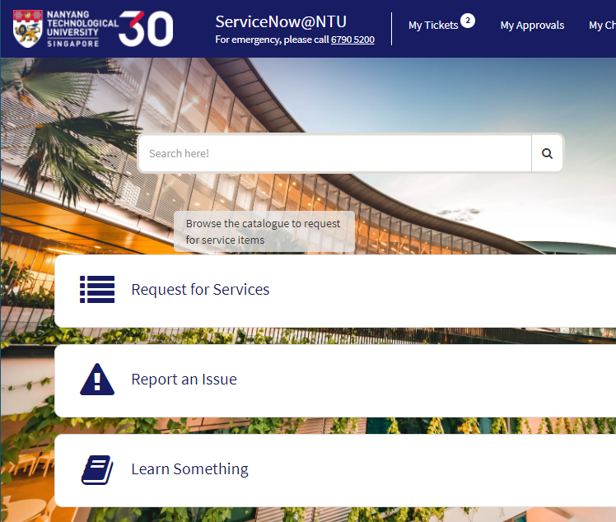
Individual Assessment Quiz – Required Software
You’ll need to bring your own laptop (fully charged) to the quiz venue with the Respondus Lockdown browser installed and tested (checked its working) using Mock Quiz (enabled on Week 10).
To install Respondus Lockdown Browser:
Go to NTU intranet and click on ServiceNow@NTUSearch for “Respondus Lockdown Browser and Monitor”
Click on “How to Take Online Test with Respondus LockDown Browser and Monitor”
If you encounter issues such as downloading or testing the lockdown browser, please contact Center for IT Services (CITS) directly

Slide 19
Individual Assessment Quiz - Attendance
Attendance is compulsory and will be taken during the quiz. If unable to attend the quiz due to the following reasons,
Medical Certificate
Compassionate Reason(s)
Official Leave of Absence (LOA) from School
Technical errors faced during main quiz (with attendance taken)
Others (case by case considerations)
please follow the procedure mentioned below to notify us if you are unable to attend or complete the quiz,
Go to https://forms.office.com/r/LzUuzkiTMy to notify us if you are unable to attend with a valid reason listed above
Submission is to be done by student, not by tutor
Documentary proof of reason must be provided
If tested covid positive, image of ART test alongside your identity document is sufficient to be the documentary proof
Email notification will not be accepted

Slide 20
Group Assessment – Team Project Assignment (35% weightage)
Team Project assignment is one of the group assessment components which is divided into two sub-components: (1) Project work, and (2) Project presentation. Project work contribute 20% whereas the project presentation 15% to the total score.
Project Work – Innovative Cross-Module Project
In this exciting assignment, each group will unleash their creative thinking and problem-solving skills by proposing an innovative idea that spans at least two out of seven modules they studied in this course. Your task is to identify problem statements within the selected/chosen CC0002 modules and to propose an approach to solve or tackle those problems. (Refer to student handbook for more details).
Project Presentation
Each group to present their project work starting from week 12 and Week 13. Five groups will be presenting their work on week 12 and the remaining five groups will be presenting on week 13. The sequence of your presentation will be announced to you all by your respective instructors. On the presentation day – each group will be given 15 minutes where - in 10 minutes using their digital poster/power point slides, each member of the team should present their part they have worked to complete this project. Remaining 5 minutes will be allocated for questions and answers session.
Project Assignment Deliverables:
Digital poster
Five-minute video created using generated AI.
Presentation
Using digital poster/power point slides
Question and Answer

Slide 21
Group Assessment – Team Project Assignment (35% weightage)
Project Assignment Components (both Project work + Presentation):
Idea Proposal and Problem Statement:
As a group, select two modules from the CC0002 course that you believe can be combined to address a meaningful real-world challenge.
Identify specific problem statements within these chosen modules that your project aims to solve or answer.
Present a concise proposal outlining your idea, including how it relates to both modules and why it’s worth pursuing.
Detailed Design Approach:
Explain the data sources that will fuel your project, detailing their relevance to each module and the overall problem.
Elaborate on the analysis methods and approaches you intend to employ. Compare the novelty of your approach with existing solutions.
Discuss how your innovative fusion of concepts from the two modules contributes to a more holistic solution.
Your design approach should be backed up with proper review of research work or journal articles.
3. Outcome and Future Possibilities:
Clearly define the anticipated outcome of your design approach. Will it answer or solve the identified problem statements?
Reflect on the potential impact of your project in addressing the challenges at hand using CC0002 concepts.
Envision and describe possible future directions for your project, such as extensions, improvements, or applications in related domains.

Slide 22
Group Assessment – Team Project Assignment (35% weightage)
Project Assignment Components (both Project work + Presentation):
4. Poster Creation and Presentation:
Create a visually appealing digital poster of size A0 or A1 (Portrait/Landscape) that concisely summarizes your project.
Include above mentioned 3 sections that introduce the problem statements, outline your approach, highlight key findings, and provide a glimpse of future possibilities.
Utilize visuals, diagrams, and infographics to make your poster engaging and easy to understand.
Your group will be presenting this created poster either using the poster or power point slides in ten minutes during the presentation slot allocated either in week 12 or week 13.
Samples of posters will be uploaded in NTULearn for your reference.
5. Video Creation:
Develop a dynamic 4 – 5 minutes video using any generative AI tools of your choice that effectively communicates your project’s essence and value.
Begin with a captivating introduction that hooks the audience and emphasizes the significance of your project design approach in the AI-driven digital world.
Provide an overview of the problem statements, showcasing your interdisciplinary approach.
Explain the data-driven and AI-powered (if any) components of your design approach, taken to obtain solution to the problem statements, by highlighting the novel aspects of your project compared to existing ones.
Conclude with a forward-looking segment that discusses the broader implications and potential future applications of your project.
Samples of videos will be uploaded in NTULearn for your reference.

Slide 23
Group Assessment – Team Project Assignment (35% weightage)
Project Assignment:
Submission Guidelines:
Submit your detailed project proposal poster in a digital format, and a link to your video. No report submission is required, only the poster and video developed must be submitted before the deadline.
Deadline to submit poster + video of your project work is on Sunday 7th, April, 11:59pm (before the presentation).
Make sure to acknowledge any external resources used and provide references where necessary.

Slide 24
Team Project Assignment - Rubrics
Criteria | Outstanding | Average | Below Average/Poor | Max Score
Project Work
Poster (10Marks) | Content and Creativity The poster was well organized and clearly written. The underlying logic was clearly articulated and easy to follow. Words were chosen that precisely expressed the intended meaning and supported reader comprehension. Diagrams or analyses enhanced and clarified presentation of ideas. Sentences were grammatical and free from errors. | Content and Creativity The poster was organised and clearly written for the most part. In some areas the logic and/or flow of ideas were difficult to follow. Words were well chosen with some minor expectations. Diagrams were consistent with the text. Sentences were mostly grammatical and/or only a few spelling errors were present, but they did not hinder the reader. | Content and Creativity The poster lacked overall organisation. The reader had to make considerable effort to understand the underlying logic and flow of ideas. Diagrams were absent or inconsistent with the text. Grammatical and spelling errors made it difficult for the reader to interpret the text in places. | 4
 | Contribution All requirements and objectives are identified, evaluated, and completed. The deliverable offered new information or approach to the topic under discussion. Likewise, the application is based on stated criteria, analysis, and constraints. | Contribution All requirements are identified and evaluated but some objectives are not completed. The deliverable offered some new information or approach to the topic under discussion. The application is reasonable; further analysis of some of the alternatives or constraints may have led to a different recommendation. | Contribution Many requirements and objectives are not identified, evaluated and/or completed. The deliverable offered no new information or approach to the topic under discussion. Few application considerations are analysed, and other factors were ignored or incompletely analysed. | 2
 | Subject Knowledge The deliverable demonstrated knowledge of the course content by integrating major and minor concepts into the response. The deliverable also demonstrated evidence of extensive research effort and a depth of thinking about the topic. | Subject Knowledge The deliverable demonstrated knowledge of the course content by integrating major concepts into the response. The deliverable also demonstrated evidence of limited research effort and/or initial of thinking about the topic. | Subject Knowledge The deliverable did not demonstrate knowledge of the course content, evidence of the research effort or depth of thinking about the topic. | 2
 | Supporting material All relevant information was obtained, and information sources were valid. Analysis and design considerations were well supported by the information. | Supporting material Sufficient information was obtained, and most sources were valid. Analysis and design considerations were mostly supported by the information. | Supporting material Insufficient information was obtained and/or sources lack validity. Analysis and design considerations were not supported by the information collected. | 2

Slide 25
Team Project Assignment – Rubrics continued
Criteria | Outstanding | Average | Below Average/Poor | Max Score
Project Work
Video (10Marks) | Video Delivery The demonstration was imaginative and effective in conveying ideas to the audience. Developed using generative AI tools. | Video Delivery The demonstration techniques used were effective in conveying main ideas, but a bit unimaginative. Only some parts are developed using generative AI tools. | Video Delivery The demonstration failed to capture the interest of the audience and/or is confusing in what was communicated. Generative AI tools are not used in video creation. | 4
 | Content and Creativity The video was well organized and clearly narrated. The underlying logic was clearly articulated and easy to follow. Audio words were chosen that precisely expressed the intended meaning and supported audience comprehension. Diagrams/Figures/Illustration or analyses enhanced and clarified ideas. Audio words were grammatical and free from errors. | Content and Creativity The video was organised and clearly narrated for the most part. In some areas the logic and/or flow of ideas were difficult to follow. Audio words were well chosen with some minor expectations. Diagrams/Figures/Illustration were consistent with the text. Audio words were mostly grammatical and/or only a few spelling errors were present, but they did not hinder the audience. | Content and Creativity The video lacked overall organisation. The audience had to make considerable effort to understand the underlying logic and flow of ideas. Diagrams/Figures/Illustrations were absent or inconsistent with the text. Grammatical and spelling errors made it difficult for the audience to interpret the audio words in places. | 4
 | Time Management Within 1-2 minutes to the time limit | Time Management Within 3 minutes to the time limit | Time Management Video either exceeds or falls behind the time limit. | 2

Slide 26
Team Project Assignment – Rubrics continued
Criteria | Outstanding | Average | Below Average/Poor | Max Score
Presentation (15 marks)
Effectiveness | Presentation includes all/most of the material needed to deliver a comfortable understanding of the topic. | Presentation is incomplete but still understandable. | Presentation is lacking multiple key elements and no longer comprehensible. | 2
Speaking Skills and Participation | Every team member spoke and participated at a very high and balanced level. Speakers demonstrated good volume; enthusiasm and confidence was exuded. | Team members were mostly audible and / or fluent on the topic. Not all team members spoke or participated in a high and balanced level. Speakers demonstrated fair volume, and light discomfort with public speaking was exuded. | Team members were often inaudible and/or hesitant and relied heavily on notes. A high level of discomfort with public speaking was exuded. | 2
Sequencing of Information | Most information is organized in a clear, logical way. It is easy to anticipate the type of material that might be on the next slides. | One can still see some logical connection between slides. However, few slides are out of place. | There is no clear plan for the organizing of information. | 2
Time Management | Within 1-2 minutes to the time limit | Within 3 minutes to the time limit | Presentation either exceeds or falls behind the time limit. | 2
Question and Answer (Knowledge) | Team demonstrated high level of subject knowledge through their answers to all the questions asked. | Team demonstrated moderate level of subject knowledge through their answers to few of the questions asked. | Team could not demonstrate the subject knowledge – not able to answer most of the questions asked. | 6
Professionalism | Completely professional. Students are ready for presentation and respectful to other presenters. | Presentation contains typos or lack of organization among members during presentation. | Students being late for their presentation or unrespectful to other presenters. | 1

Slide 27
Group Assessment Team Project Assignment + Peer Evaluation
Team assignment score is subjected to adjustment based on peer evaluation. Please refer to the table below for more details on the adjustment done.
Average Rating Range (min: 1; max: 9) | Marks Deduction (out of 100%) | Final Adjusted Marks (out of 100%)
≥ 6.5 | 0% | Original team assignment mark (M%)
≥ 5.5 to < 6.5 | -5% | M% – 5%
≥ 4.0 to < 5.5 | -10% | M% – 10%
≥ 3.0 to < 4.0 | -15% | M% – 15%
> 1.0 to < 3.0 | -20% | M% – 20%
= 1.0 | -M% | 0%

Slide 28
Peer Evaluation
All team members are expected to complete the peer evaluation for all other members in the team (i.e., self-assessment is not required) Should a student fail to complete the peer evaluation of all other members in his/her group, 5% will be deducted from the student’s final team assignment mark.
All assessments and qualitative comments are confidential. (Note: Students should avoid identifying themselves in any manner when providing qualitative comments to their team members.)
Please complete the peer evaluation through the evaluation platform in NTULearn (enabled in week 8) for all your team members for the team assignment no later than deadline 18th April 2024.

Slide 29
Peer Evaluation
4. Each member’s average rating given by his/her team members will be used to
determine the final team assignment marks awarded to each member.
Please note that the teaching team reserves the right to adjust students’ final team assignment marks based on additional considerations including gathered information, certified special education needs (SEN), and medical diagnosis.

Slide 30
Group Assessment – Class Participation (10% weightage) + in-class Presentation & Discussion (10% weightage)
Students are required to attend the tutorials weekly they are assigned, and attendance is compulsory.
In each tutorial, the participation of student in discussion, presentation and any other mode of assessments given by their respective tutor will be graded.
Class participation carries weightage of 10% whereas
in-class presentation by team & discussion carries weightage of 10% to the total marks.

Slide 31
Miscellaneous Information – Contact details
For course related matter, contact
icc-cc0002@ntu.edu.sg
For tutorial class related matter, contact your individual tutor (email address from slide numbers 7-11)

Slide 32
Students are expected to complete all videos and submit all assessments by due dates.
Good academic work depends on honesty and ethical behavior. The quality of your work as a student relies on adhering to the principles of academic integrity and the NTU Honor Code, a set of values shared by the whole university community. Truth, Trust, and Justice are at the core of NTU’s shared values.
As a student, it is important that you recognize your responsibilities in understanding and applying the principles of academic integrity in all the work you do at NTU. Not knowing what is involved in maintaining academic integrity does not excuse academic dishonesty. If you are uncertain of the definitions of any of these terms, you should refer to the academic integrity handbook for more information.
Consult your instructor(s) if you need any clarification about the requirements of academic integrity in the course.
Course Policy

